Slide 1


Xccelerate.co
Data Science - Tableau Part II
Topics Covered:
Tableau Filtering/ Marking
Tableau Analysis

Slide 2

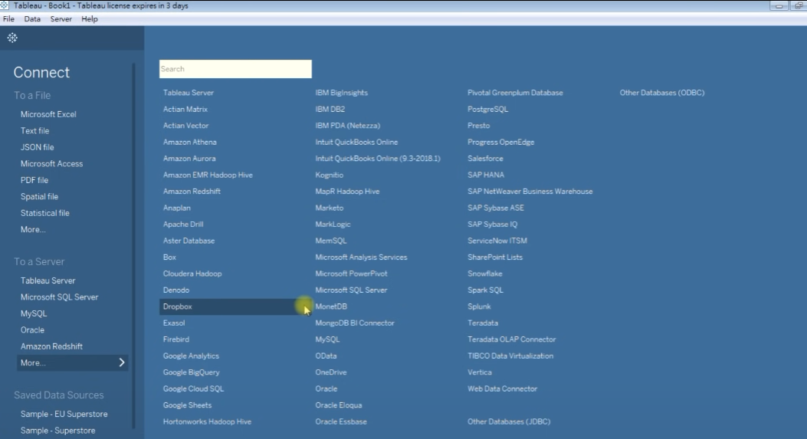
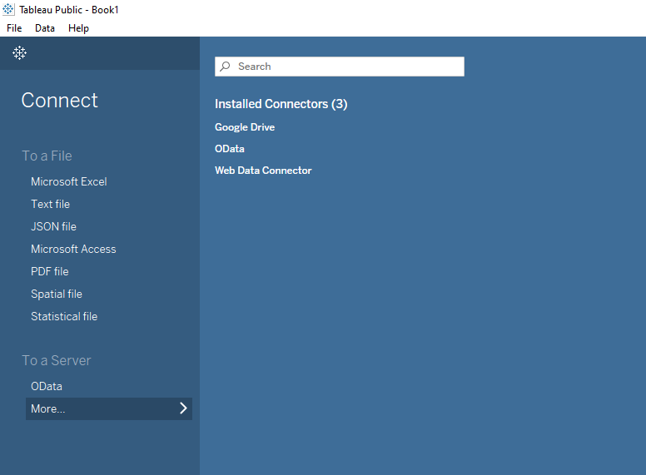

Tableau’s Paid version
Notes:
https://forms.gle/jnob3YLb33f7Zxcw5 - Feedback form

Slide 3
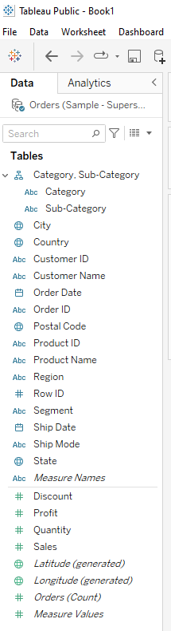
Yesterday we talked about…
Dimension vs Measures
Dimensions = Discrete values
Measures = Continuous value
Able to be aggregated (.SUM/.COUNT/ … (SQL))
Dimensions
Measures

Slide 4
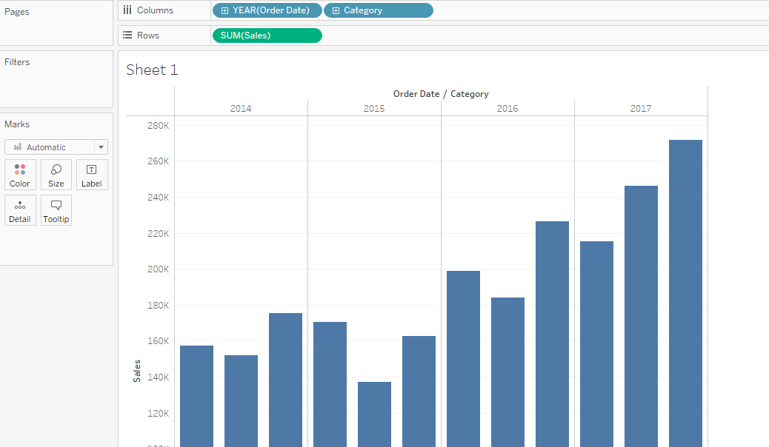
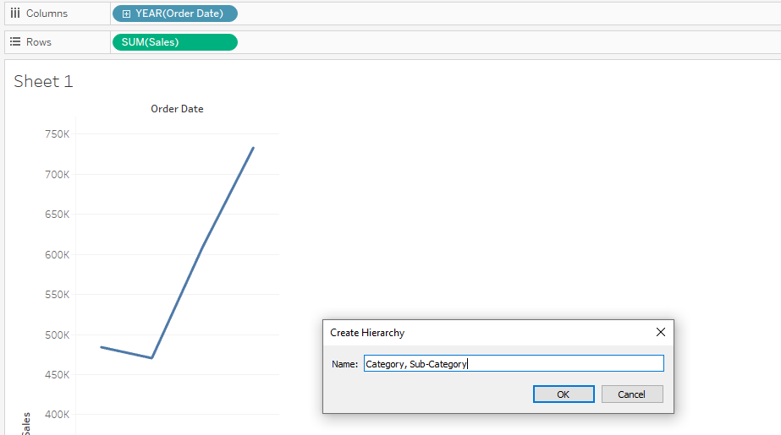
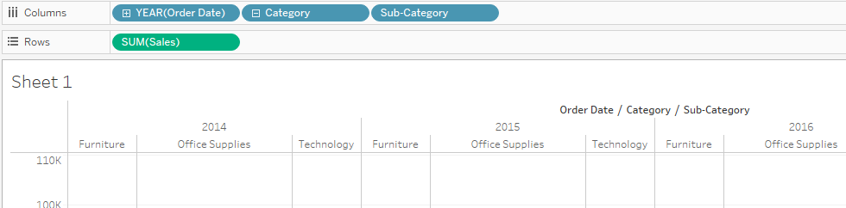
Yesterday we talked about…
Expand
Hierarchical order - Creating Hierarchy
Drag “Category” and combine with
“Sub-Category”
Added Hierarchical Category
Step 1 to 2
Step 2 to 3

Slide 5
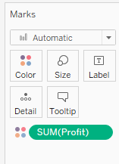

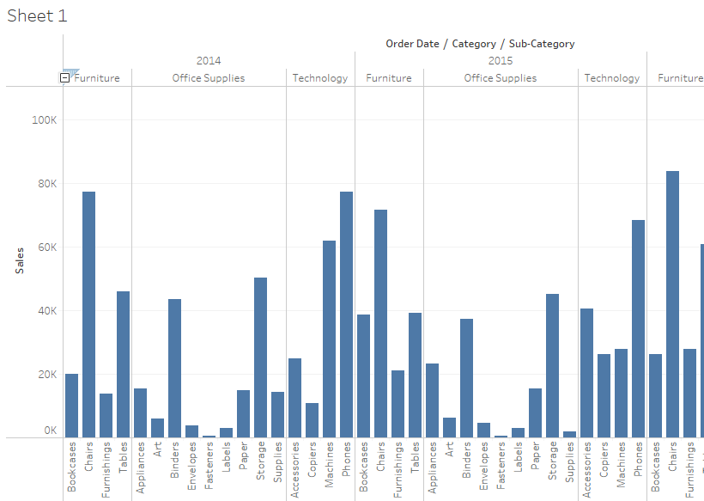
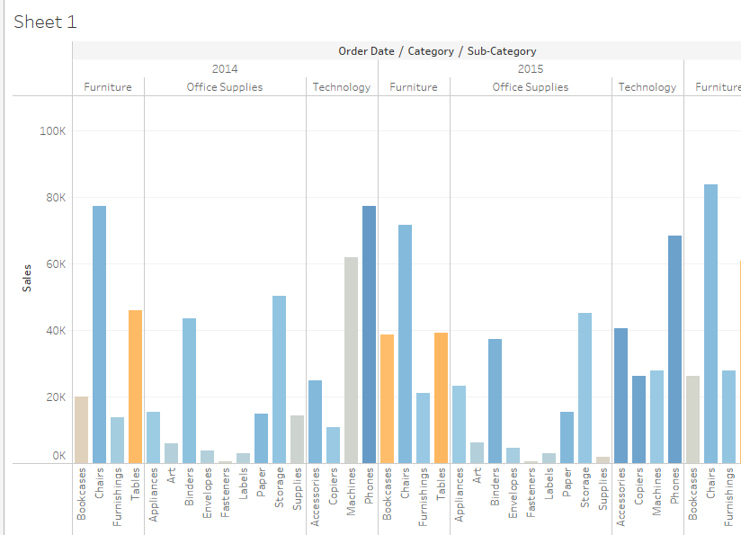
Tableau Marking
Drag Measure: Profit into Mark: Color
Default = SUM (Profit)
Before
After
Notes:
Feel free to click on one of the columns for descriptions. Whether it be positive or negative profits (Color blue vs orange)
Double click on the SUM(Profit) grid to edit the colors for positives and negatives.
Click on one of the bars on the chart, to pin-point certain sub categories

Slide 6
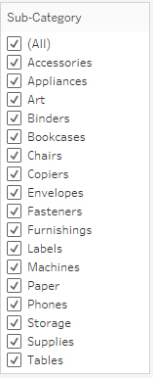
Tableau Filtering 1
For better pinpointing sub-catogories
RMB sub-category & click “show filter”
You should see this box on the right ->
Uncheck EVERYTHING except:
Machines, Bookcases, Tables
Then on Columns, RMB on Sub-category
Select “Show highlighter”

Slide 7
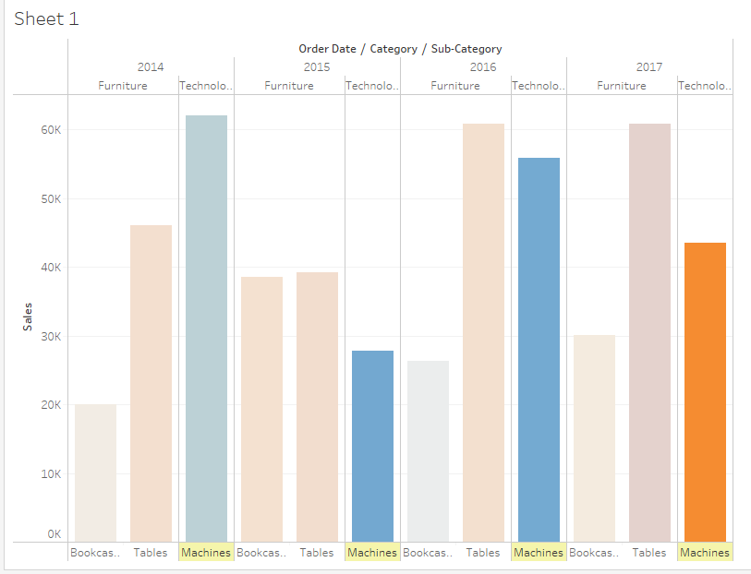
Tableau Filtering 2
Click on the Highlight Sub-category search window
Select “Machines”
Very useful,
Let’s pinpoint
Why is 2017 the only year
Machines are losing money…
Any guesses?

Slide 8

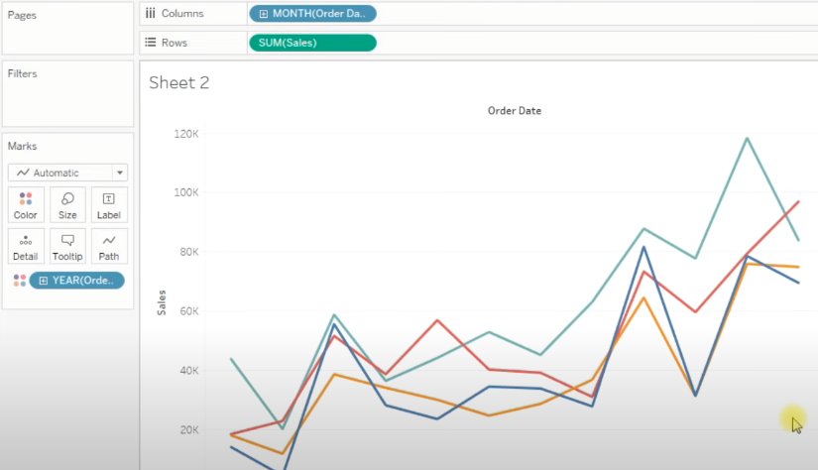
Tableau Analysis 1
Start off by renaming your “Sheet1” -> Analysis
Start new sheet,
and do the following set up
Note:
MONTH(OrderDate) for Columns
Don’t forget !
Marks OrderDate -> Mark’s color

Slide 9
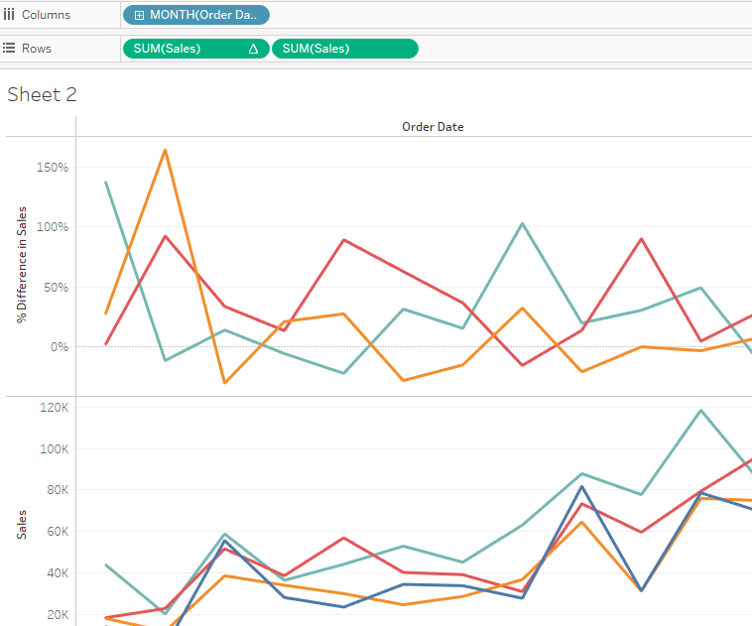
Tableau Analysis 2
RMB on SUM(Sales) on Rows
Go to “Quick Table Calculation”
Select “Year over Year growth”
Add another SUM(Sales) on Rows
Note:
One of the SUM(Sales) is not like the other
One is a %
The other is a sum count
Highlighting %Difference vs raw sum count of Sales

Slide 10
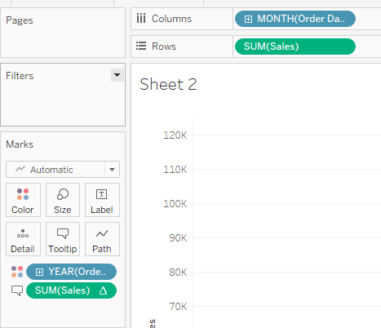
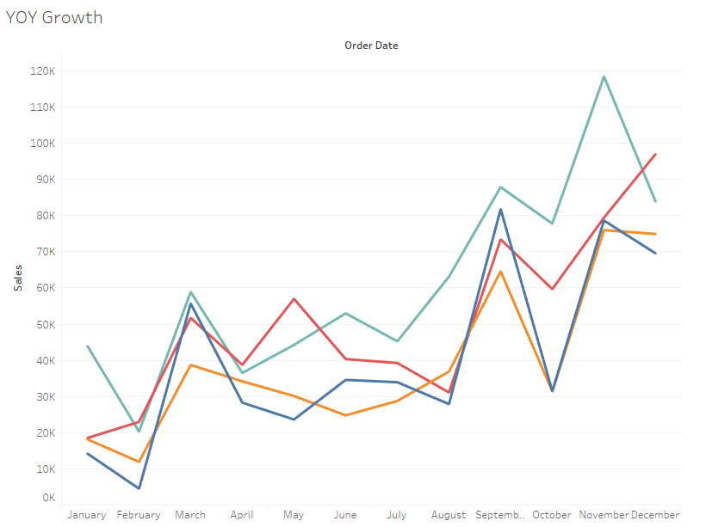
Tableau Analysis 3
Move the %(Year on Year)
Drag it from Rows to Tooltip
<- It should look like this on the left
Now,
As you hover to parts of the Curve
on the chart
You will get more info
% Difference will get embedded
Rename sheet to YOY growth

Slide 11
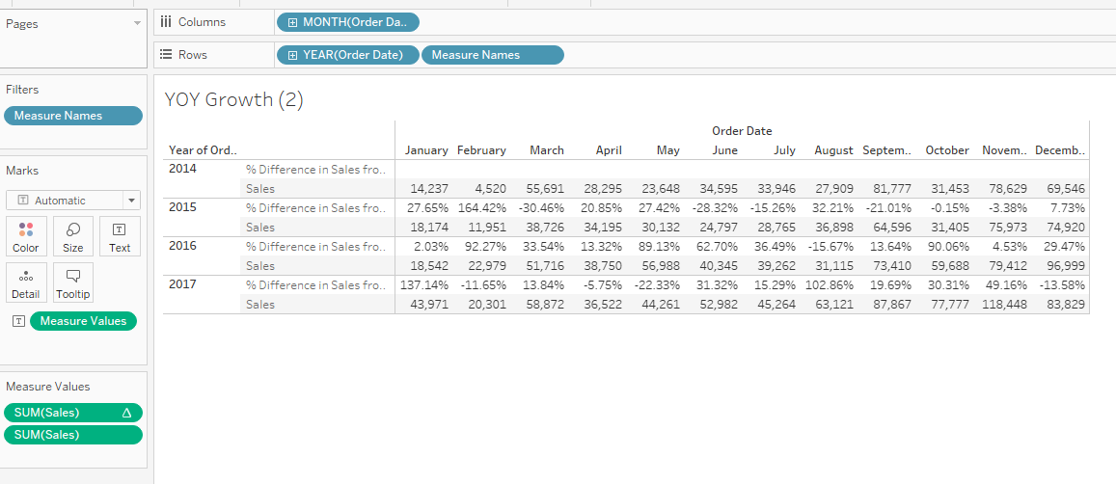
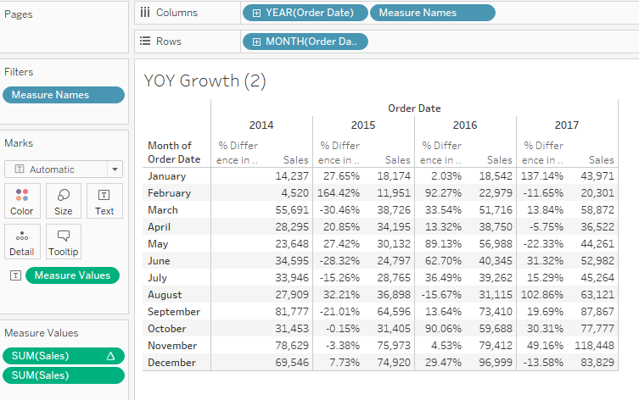
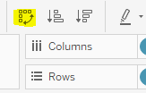
Tableau Analysis 4
On the same sheet “YOY Growth”
Trigger Cross-tab by
RMB the YOY Growth Sheet
Click “Duplicate as Crosstab”
A new sheet should be created
We pivot rotate the rows/columns
We do so by clicking on this:
Ctrl + W
OR
Clicking on the button that top-left from the column tab

Slide 12
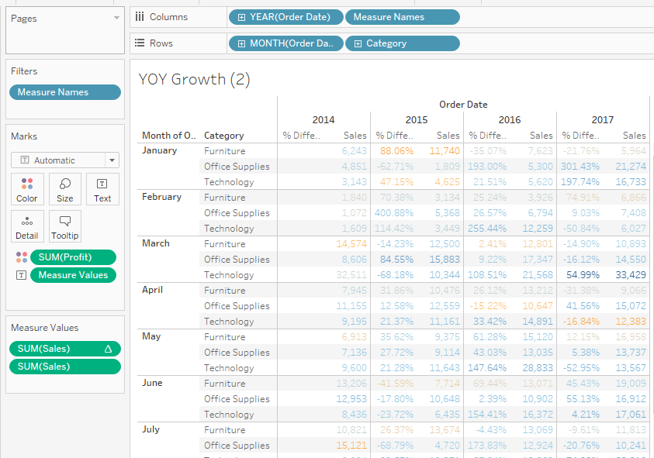
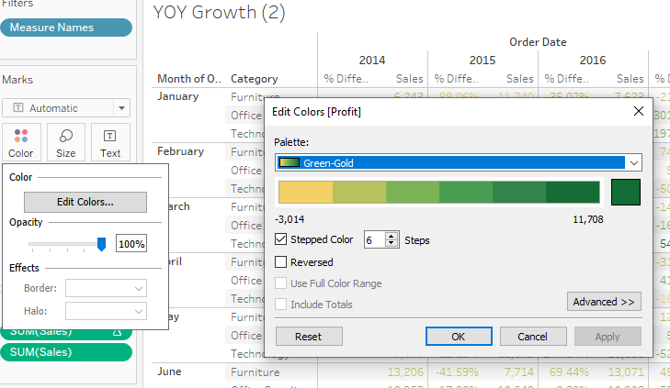
Tableau Analysis 5
Add 2 more things:
Add Category into Rows
Add Profit into Mark’s color
Results:
Color looks faint
Click on Color -> Edit Colors
Pick Green-gold from Palette
And Activate stepped color
increase it from 5 -> 6

Slide 13
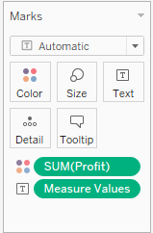
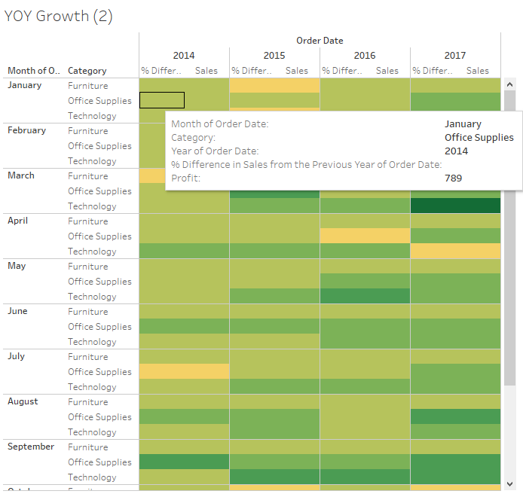
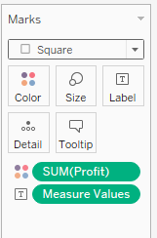

Tableau Analysis 6
Switch views:
Auto -> Square
Trigger Text
By clicking on:
Show text labels
Now that the profit shown was a lot more descriptive! Awesome!

